Slide 1


Unit 1
CSPro application basics
Notes:
Welcome to Unit 1 of Module 4.

Slide 2
By the end of this unit, you will be able to:
explain how to register a device for data collection
describe the CSPro application screen elements and response options
Notes:
By the end of this unit, you will be able to:
explain how to register a device for data collection;
describe the CSPro application screen elements and response options.

Slide 3

Starting CSPro
To start CSPro, click on the CSEntry icon on your device.
This will take you to the Entry applications screen.
Notes:
To start CSPro, click on the CSEntry icon on your device.
This will take you to the Entry applications screen.

Slide 4
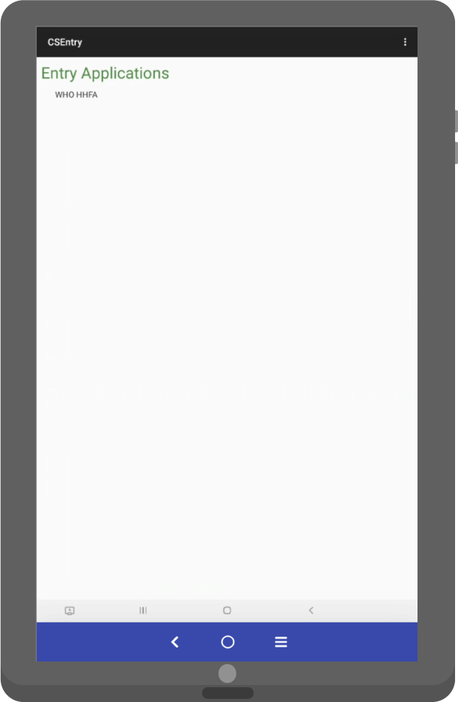
Entry applications screen
WHO HHFA application
When opening CSEntry:
all data entry applications are displayed
click on an application to open it
if only one application is on the device, it will open automatically
Notes:
When opening CSEntry, all data entry applications on the device are displayed.
To open an application, click on it.
If only one application is on the device, it will open automatically.
In this example, there is only one application, the WHO HHFA application, so it will open automatically.

Slide 5
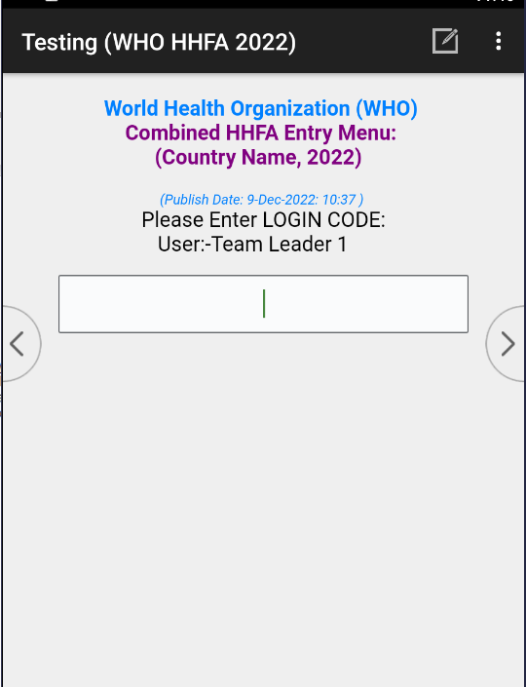
Login screen elements
Survey country and year of survey
Application publish date and time
User who has
pre-registered the device (blank if not registered)
Window to enter the login code to access the main menu
Notes:
Opening the HHFA application from the Entry Applications List brings you to the Login screen, which contains:
the survey country and year of survey;
the application publish date and time;
the user who has pre-registered the device (if no user has registered the device, this text will be blank); and
a window to enter the login code to access the main menu.

Slide 6
Device registration
Device registration restricts a data collection device to a single user.
Why is this needed?
if a data collector logs into 2 different devices to collect data, this will result in duplication and/or data loss
if a team leader logs into 2 different devices and syncs data, this will result in duplication of data on the central server
Notes:
Device registration restricts a data collection device to a single user.
This is needed because:
if a data collector logs into 2 different devices to collect data for the same facility, this will result in duplication and/or data loss; and
if a team leader logs into 2 different devices and syncs data, this will result in duplication of data on the central server.

Slide 7



Device registration
Restrict registration to 1 device per:
data collector
team leader
supervisor
Notes:
To resolve this, we must restrict registration to 1 device per data collector, team leader, or supervisor.
Let’s look at how to register a device.

Slide 8
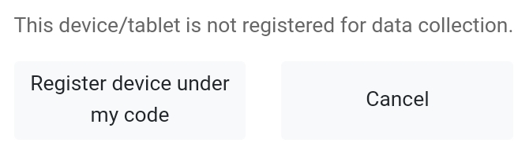
Device registration
Notes:
On initial login into the device, you will be prompted to register the device under your code.

Slide 9
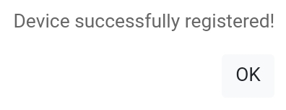
Device registration
Notes:
Once the correct code is entered, a message to confirm successful registration will appear.

Slide 10
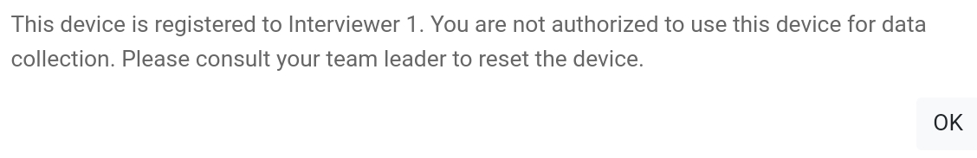
Device registration
Notes:
If you attempt to log in to a device that has already been registered, you will get this error message.

Slide 11
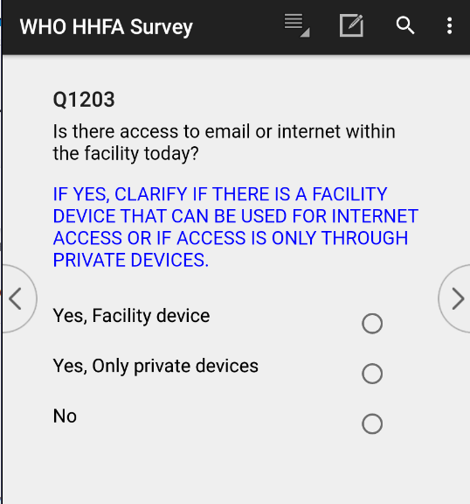
Questionnaire screen elements
1
Survey name
5
Question number
2
User menu
6
Question text
3
Pencil and paper icon
7
Response options
4
8
Left- and right-hand navigation buttons
Search icon
Notes:
Let’s now look at the organization of the screen elements used when answering questions within CSPro.
There are 8 screen elements that data collectors need to know about.

Slide 12
Questionnaire screen elements
1. The name of the survey
Notes:
The name of the survey.

Slide 13
Questionnaire screen elements
2. The user menu icon, with data entry functions
Clicking on this icon will display a list of navigation options used during data entry.
Notes:
The user menu icon, with data entry functions.
Clicking on this icon will display a list of navigation options used during data entry.

Slide 14
Questionnaire screen elements
3. The pencil and paper icon
Clicking on this icon displays a screen to type a field-specific note.
Notes:
The pencil and paper icon.
Clicking on this icon displays a screen to type a field-specific note.

Slide 15
Questionnaire screen elements
4. The search icon
Clicking on this icon and typing in a query allows you to filter the response listing.
Notes:
The search icon.
Clicking on this icon and typing in a query allows you to filter the response listing.

Slide 16
Questionnaire screen elements
5. The question number
Notes:
The question number.

Slide 17
Questionnaire screen elements
6. The question text
Question text appearing in BLUE are instructions to the data collector.
Notes:
The question text.
Question text appearing in BLUE are instructions to the data collector.

Slide 18
Questionnaire screen elements
7. The response options
Notes:
The response options.

Slide 19
Questionnaire screen elements
8. The left-hand navigation button
8. The right-hand navigation button
These buttons enable you to move forwards or backwards in the data entry application.
Notes:
The left- and right-hand navigation buttons.
These buttons enable you to move forwards or backwards in the data entry application.

Slide 20
Questionnaire response options
1
Radio buttons
3
Combo box
2
Numeric field
4
Text box
Notes:
There are 4 kinds of response options in the CSPro application:
radio buttons;
a numeric field;
combo box; and
text box.

Slide 21
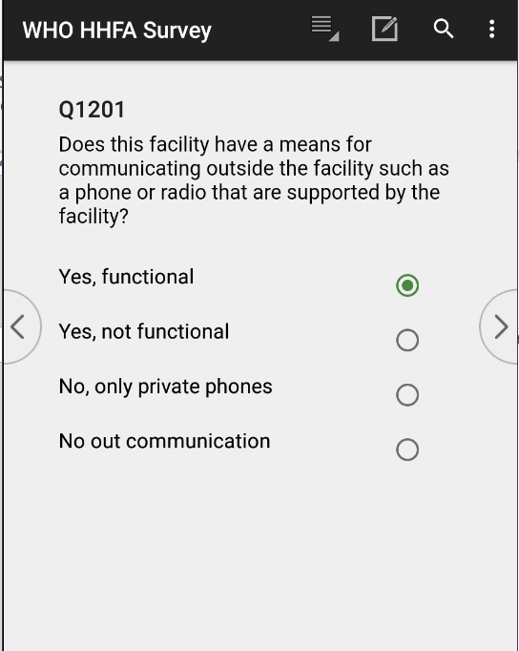
1. Radio buttons
When presented with a list of radio buttons:
only one can be selected
Notes:
When presented with a list of radio buttons, only one can be selected.
Radio buttons are the same as the single answer options in the paper questionnaire.

Slide 22
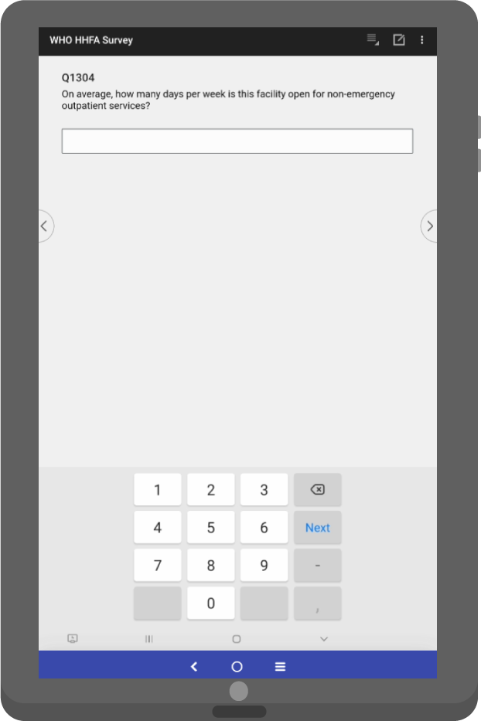
2. Numeric field
Number between 1 and 7
A numeric field allows for a response that is a number only.
Often a range will be set so only valid numeric responses can be entered.
Notes:
A numeric field allows for a response that is a number only.
Often a range will be set so only valid numeric responses can be entered.
In this example, in which we are asking how many days per week the facility is open for non-emergency outpatient services, the number of days per week must be a number between 1 and 7.

Slide 23
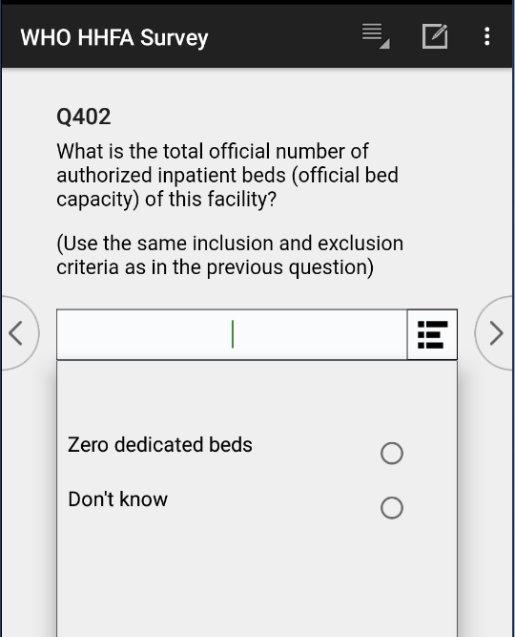
3. Combo box
A combo box is used when a question requires a numeric response, but pre-coded responses have been provided for options such as “None” or “Don’t know”.
Or enter a number
Click on the filter
You can see the radio button-type responses allowed
Select an option
Notes:
A combo box is used when a question requires a numeric response, but pre-coded responses have been provided for options such as “None” or “Don’t know”.
When you click on the filter to the right of the numeric response box, you can see the radio button-type responses allowed and can then select one, or enter a number if the response does not match the option.

Slide 24
3. Combo box
For example:
if the respondent says the number of authorized inpatient beds in the facility is 18, the data collector enters the number 18
18
if the respondent says there are no authorized inpatient beds, the data collector selects ‘Zero dedicated beds’
Notes:
For example:
if the respondent says that the total official number of authorized inpatient beds in the facility is 18, the data collector will need to enter the number 18;
if the respondent says there are no authorized inpatient beds, the data collector would select the ‘Zero dedicated beds’ radio button.

Slide 25
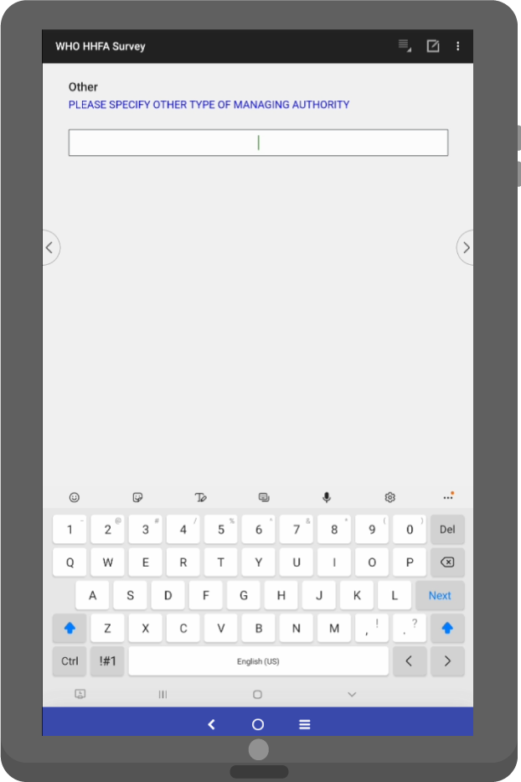
4. Text box
To enter data in a text box field, the data collector needs to type the response using the keyboard.
If a keyboard does not appear automatically, clicking on the field will make the keyboard appear.
Notes:
To enter data in a text box field, the data collector needs to type the response using the keyboard.
If a keyboard does not appear automatically, clicking on the field will make the keyboard appear.

Slide 26
You have now completed Unit 1.
In the next unit, we will look at key user roles within the HHFA CSPro system.
Notes:
You have now completed Unit 1.
In the next unit, we will look at key user roles within the HHFA CSPro system.

